Slide 1

INTEGER PROGRAMMING
SCHOOL OF DATA SCIENCE AND FORECASTING
DEVI AHILYA VISHWAVIDYALAYA, INDORE

Slide 2
Integer Programming
There are several problems where integer solutions are required e.g. optimal number of cargo ships, apartment houses, airplanes, etc. In such cases rounding to the nearest integer will not be useful as huge cost is involved.
An integer programming model is one where at least one of the decision variable has to take on an integer value in the final solution.
The mathematical model for integer programming is same as linear programming model except an additional restriction that the some or all variables must have integer values.
Solving an integer programming problem is more complex than solving an LP problem.

Slide 3
Types of Integer Programming Problems
Pure-Integer Problems:
Problems requiring that all decision variables should have integer values are referred to as pure-integer problems. Examples-Production of airplanes, cargo ships, etc.
Mixed-Integer Problems:
In mixed-integer problems, some but not all decision variables need to have integer values in the final solution, whereas other decision variables need not to have integer values. Example-investment decision on portfolio of investments that include shares of a listed company and/or land. In general land is continuous variable e.g. 3.5 acres and number of shares is integer.
0-1 Problems:
There are some situations in which decision in the form of ‘yes’ or ‘no’ is required. Such problems are known as 0-1 integer programming problems. Example-decision on replacement of a machine with new one, answer will be yes (1) or no (0).

Slide 4
Formulation of Integer Programming Problems
Pure-Integer Programming Problem:
A jewelry shop manager has planned to limit the use of diamonds to the artistic configuration of diamond rings, diamond earnings and diamond necklaces. The three items require the following specifications:
The manager does not want to configure the diamond into more than 50 items. The per unit profit for the rings is Rs. 1500, for pair of earnings is Rs. 2400 and for necklace is Rs. 3600. Formulate the problem as an Integer Programming model for maximizing the profit.
Ornament | Diamond
 | ½ carat | ¼ carat
Ring | 4 | 6
Earnings (Pair) | 3 | 5
Necklace | 10 | 9
Availability | 150 | 160

Slide 5
Formulation of Integer Programming Problems
Pure-Integer Programming Problem:
Decision Variables:
Assume,
X₁ = Number of diamond rings
X₂ = Number of pair of earrings
X₃ = Number of necklaces
Objective Function:
Max. Z = 1500X₁ + 2400X₂ + 3600X₃
Subject to:
4X₁ + 3X₂ + 10X₃ ≤ 150 (1/2 Carat Diamond)
6X₁ + 5X₂ + 9X₃ ≤ 160 (1/4 Carat Diamond)
X₁ + X₂ + X₃ ≤ 50 (Total Number of items)
X₁, X₂, X₃ ≥ 0; and integer.

Slide 6
Formulation of Integer Programming Problems
Mixed Integer Programming Problem:
A textile company can use any or all of three different processes for weaving in standard white polyester fabric. Each of these production processes has a weaving machine setup cost and per square-meter processing cost. These costs and the capacities of each of the three production processes are shown below:
The daily demand forecasts for its white polyester fabric is 4000 Sq. meter. The company’s production manager wants to determine the optimal combination of the production processes and their actual daily production levels such that the total production cost is minimized.
Process Number | Weaving Machine Setup cost (Rs.) | Processing Cost (Rs.) | Maximum daily capacity (Sq. meter)
1 | 150 | 15 | 2000
2 | 240 | 10 | 3000
3 | 300 | 8 | 3500

Slide 7
Formulation of Integer Programming Problems
Mixed Integer Programming Problem:
Decision Variables:
X_{i} be the production level for process Y_{i} (i = 1, 2, 3)
Y_{i} = 1 if process i is used, and
Y_{i} = 0 if process i is not used
Objective Function:
Minimize Z = (15X₁ + 10X₂ + 8X₃) + (150Y₁ + 240Y₂ + 300Y₃ )
Subject to:
X₁ + X₂ + X₃ = 4000 (Daily Demand)
X₁ – 2000Y₁ ≤ 0 (Daily Capacity of Process-1)
X₂ – 3000Y₂ ≤ 0 (Daily Capacity of Process-2)
X₃ – 3500Y₃ ≤ 0 (Daily Capacity of Process-3)
X_{i} ≥ 0; Y_{i} = 0 or 1, i= 1, 2, 3

Slide 8
Formulation of Integer Programming Problems
0-1 Integer Programming Problem:
A real estate development firm is considering five possible development projects. The following table shows the estimated long-run profit (net present value) that each project would generate, as well as the amount of investment required to undertake the project, in units of Rs. Crores
The firm has raised Rs. 20 Crores of investment capital for these projects. Now it wants to select the combination of projects that will maximize total estimated long-run profit (net present value) with investment not more than Rs 20 Crores. Formulate a Binary Integer Programming (0–1) model for this problem.
 | Development Project
 | 1 | 2 | 3 | 4 | 5
Estimated long-run Profit | 1 | 1.8 | 1.6 | 0.8 | 1.4
Capital Required | 6 | 12 | 10 | 4 | 8

Slide 9
Formulation of Integer Programming Problems
0-1 Integer Programming Problem:
Let,
x_{i} = 1 if investment is made in project i
x_{i} = 0 if investment is not made in project i
i = 1,2,3,4,5
Objective Function:
Max. Z= x₁ + 1.8x₂ + 1.6x₃ + 0.8x₄ + 1.4x₅
Constraints:
6x₁ + 12x₂ + 10x₃ + 4x₄ + 8x₅ ≤ 20
x_{1,} x_{2,} x_{3,} x_{4,} x₅ are 1 or 0

Slide 10
Integer Programming-Solution Methods
Branch and Bound Method:
Pure-Integer Programming
Mixed-Integer Programming
Enumeration Method:
0-1 Integer Programming

Slide 11
Branch and Bound Method
Branch and Bound Method:
A method of analyzing integer programming problems that reduces a problem to smaller and smaller subsets through a succession of branches and bounds in the process of finding the optimal integer solution.
Branch:
Selection of an integer value of a decision variable to examine for a possible integer solution to a problem.
Bound:
An upper or lower limit on the value of the objective function at a given stage of the analysis of an integer programming problem.
LP Relaxation Solution:
Solution of an integer programming problem that does not take into account the integer requirements. Used as a starting point for the branch and bound method.

Slide 12
Branch and Bound Method
Steps:
Solve the problem as if it were a standard LP problem ignoring any integer requirements.
If all variables need to be integer have integer values, this is the optimal integer solution. If any variables with integer requirements are non-integer, this is not the optimal solution. Using the values of the variables for this solution, compute the value of the objective function. This is the upper bound, no feasible solution can give a better value.
Identify the non-integer values variables with integer requirements. Select the variable having largest fractional part for branching-round it both up and down to integer values. For the lower integer value, formulate a constraint requiring that this variable cannot exceed this lower value. For the upper integer value, formulate a constraint requiring that this variable must equal or exceed this upper value.

Slide 13
Branch and Bound Method
Steps:
4. Solve two new problems-each corresponds to the original problem and a new added constraint. For each node (problem) one of the three possibilities will materialize:
All required variables will be integer. This may be the optimal solution. Compute the upper bound for this solution. Stop branching from this node of the tree. This upper bound is now a standard for comparison with other nodes. Stop branching from any node if its upper bound does not exceed this node’s value. For nodes with higher upper bounds, return to step 3.
The solution will be infeasible. Again stop branching on this portion of the tree, but consider other portions. Return to step 3.
If some integer required variables are still non-integer, compute the upper bound for this node. If any non-integer nodes exist, compare the upper bound of this node to the highest upper bound of the all integer nodes. If it exceeds that value, return to step 3. Otherwise stop branching from this node and consider other nodes using step 3.
5. The optimal integer solution is found when the value of the objective function at a node with all integer values is not exceeded by the upper bound of any other node, whether they represent all integers or not.

Slide 14
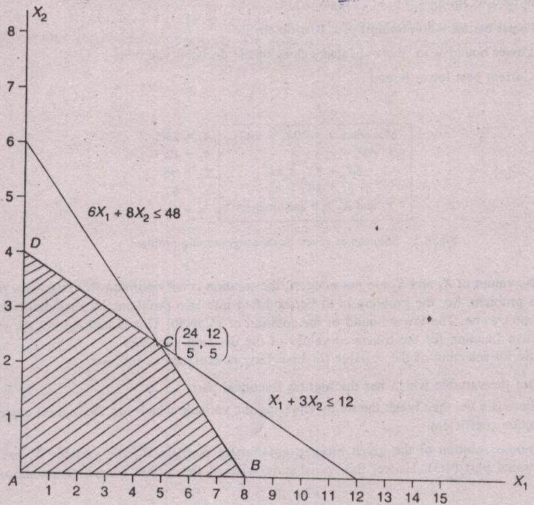
Branch and Bound Method (Example)
Max. Z = 10X₁ + 20X₂
Subject to:
6X₁ + 8X₂ ≤ 48
X₁ + 3X₂ ≤ 12
X₁, X₂ ≥ 0 and integers
Use Graphical or Simplex Method
LP Relaxation Solution
(Graphical):
Z= 96
X₁ = 24/5 = 4.80
X₂ = 12/5 = 2.40
Z (A) = 10 (0) + 20 (0) = 0
Z(B) = 10 (8) + 20 (0) = 80
Z(C) = 10 (24/5) + 20 (12/5) = 96
Z(D) = 10 (0) + 20 (4) = 80

Slide 15
Branch and Bound Method (Example)
Node 1 summarizes the LP Relaxation Solution. Both variables required to be integer. Select the variable having largest fractional part for branching (Here X₁).
1
Z=96
For Node 3
Max. Z = 10X₁ + 20X₂
Subject to:
6X₁ + 8X₂ ≤ 48
X₁ + 3X₂ ≤ 12
X₁ ≥ 5 New Constraint
X₁, X₂ ≥ 0 and integers
For Node 2
Max. Z = 10X₁ + 20X₂
Subject to:
6X₁ + 8X₂ ≤ 48
X₁ + 3X₂ ≤ 12
X₁ ≤ 4 New Constraint
X₁, X₂ ≥ 0 and integers
X₁ = 4.80
X₂ = 2.40
X₁ ≤ 4
X₁ ≥ 5
2
3

Slide 16
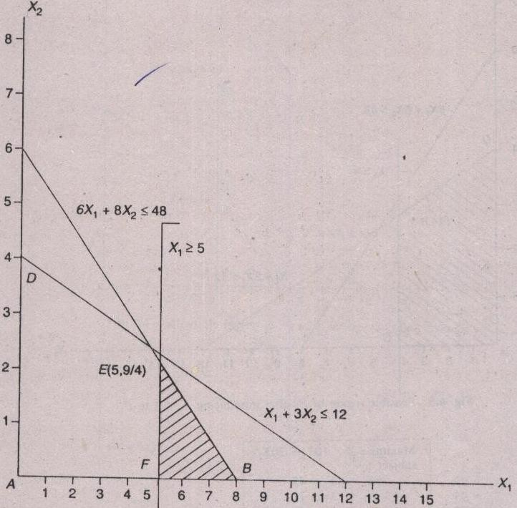
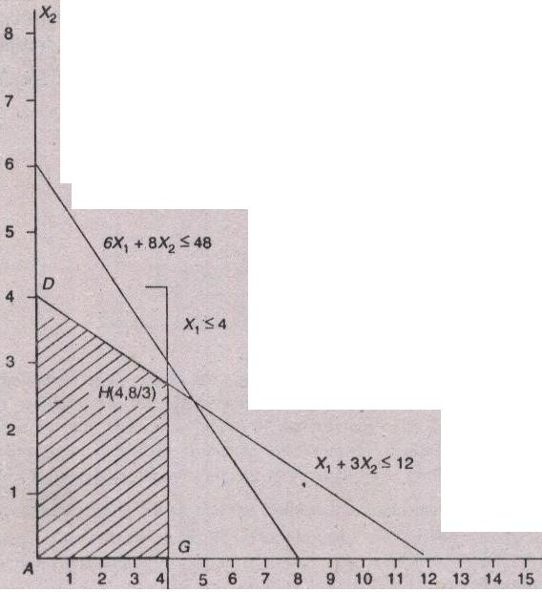
Branch and Bound Method (Example)
Node 2:on of P₃ after
introduction X1 ≤ 4 to P₁
Node 3:
Feasible Region after
Adding X₁ ≤ 4
Feasible Region after
Adding X₁ ≥ 5
Solution:
Z=93.33
X₁ = 4
X₂ = 8/3
Solution:
Z=95
X₁ = 5
X₂ = 2.25

Slide 17
Branch and Bound Method (Example)
Z value at Node 3 > Z value at Node 2. Therefore, further branching will be carried out from Node 3.
1
Z=96
In case of Minimization further branching will be done from the node having lower Z value.
X₁ = 4.80
X₂ = 2.40
X₁ ≤ 4
X₁ ≥ 5
2
3
For Node 4
Max. Z = 10X₁ + 20X₂
Subject to:
6X₁ + 8X₂ ≤ 48
X₁ + 3X₂ ≤ 12
X₁ ≥ 5
X₂ ≤ 2 New Constraint
X₁, X₂ ≥ 0 and integers
For Node 5
Max. Z = 10X₁ + 20X₂
Subject to:
6X₁ + 8X₂ ≤ 48
X₁ + 3X₂ ≤ 12
X₁ ≥ 5
X₂ ≥ 3 New Constraint
X₁, X₂ ≥ 0 and integers
Z = 93.33
Z = 95
X₁ = 5
X₂ = 2.25
X₁ = 4
X₂ = 8/3
X₂≤ 2
X₂ ≥ 3
4
5

Slide 18
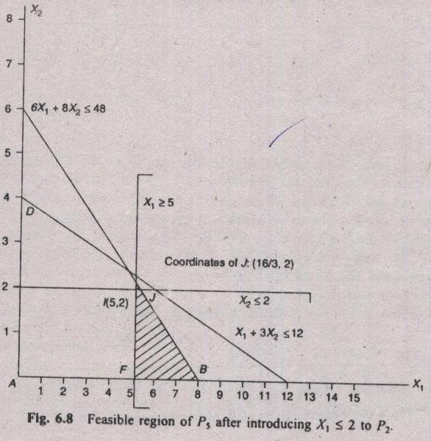
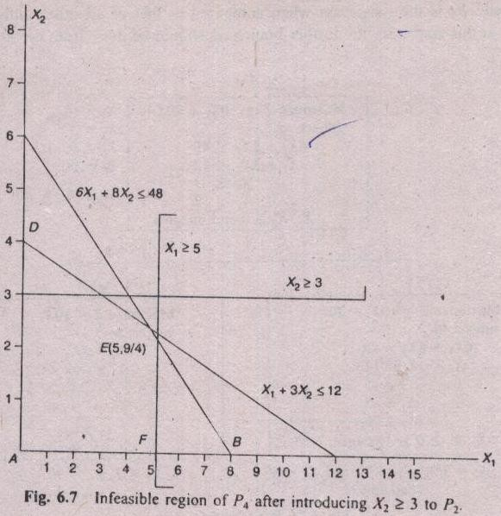
Branch and Bound Method (Example)
Node 4:on of P₃ after
introduction X1 ≤ 4 to P₁
Node 5:
No Feasible Region
Feasible Region after adding X₂ ≤ 2
Solution:
Z=93.33
X₁ = 5.33
X₂ = 2
Solution:
Infeasible

Slide 19
Branch and Bound Method (Example)
Z value at Node 2 = Z value at Node 4. Therefore, further branching will be carried out simultaneously from Node 2 Node 4.
1
For Node 7
Max. Z = 10X₁ + 20X₂
Subject to:
6X₁ + 8X₂ ≤ 48
X₁ + 3X₂ ≤ 12
X₁ ≥ 5
X₂ ≤ 2
X₁ ≥ 6 New Constraint
X₁, X₂ ≥ 0 and integers
For Node 6
Max. Z = 10X₁ + 20X₂
Subject to:
6X₁ + 8X₂ ≤ 48
X₁ + 3X₂ ≤ 12
X₁ ≥ 5
X₂ ≤ 2
X₁ ≤ 5 New Constraint
X₁, X₂ ≥ 0 and integers
Z=96
X₁ = 4.80
X₂ = 2.40
X₁ ≤ 4
X₁ ≥ 5
2
3
Z = 93.33
X₁ = 4
X₂ = 8/3
Z = 95
X₁ = 5
X₂ = 2.25
X₂≤ 2
X₂ ≥ 3
4
X₁ = 5.33
X₂ = 2
5
X₂≤ 2
Z = 93.33
Infeasible
X₂ ≥ 3
X₁ ≤ 5
X₁ ≥ 6
8
9
6
7

Slide 20
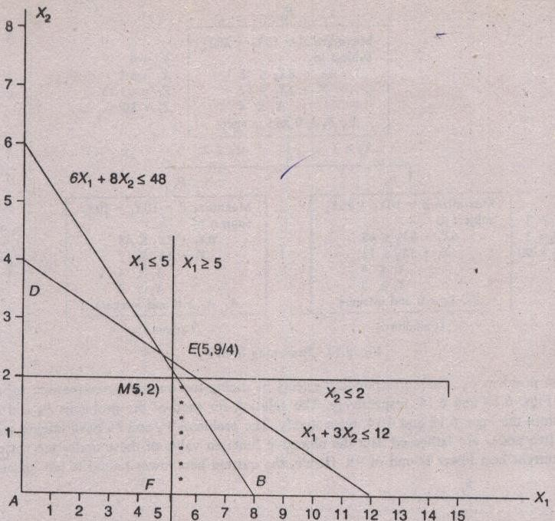
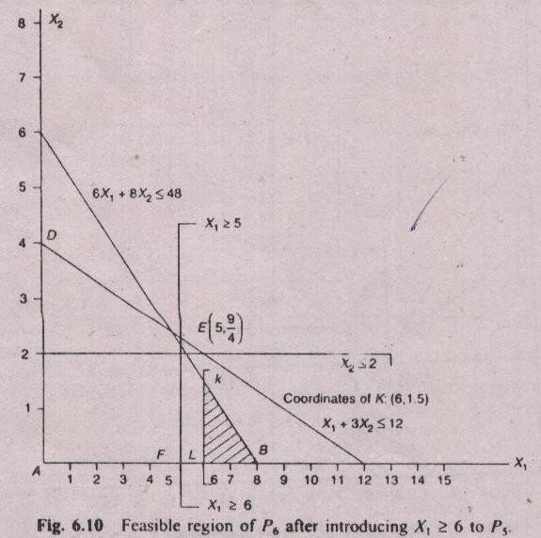
Branch and Bound Method (Example)
Node 6
Node 7
Solution
Z=90 X₁ = 6 X₂ = 1.5
Solution
Z=90 X₁ = 5 X₂ = 2

Slide 21
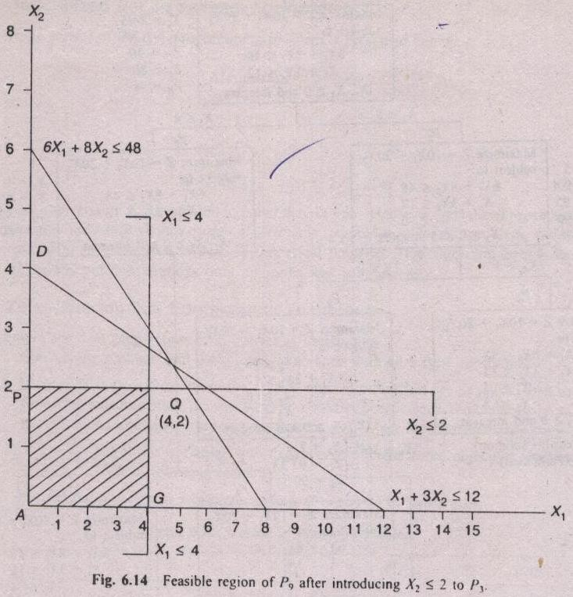
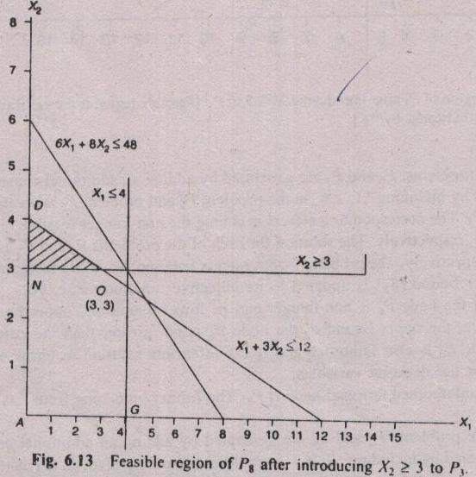
Branch and Bound Method (Example)
Node 8
Node 9
For Node 8
Max. Z = 10X₁ + 20X₂
Subject to:
6X₁ + 8X₂ ≤ 48
X₁ + 3X₂ ≤ 12
X₁ ≤ 4
X₂ ≥ 3 New Constraint
X₁, X₂ ≥ 0 and integers
For Node 8
Max. Z = 10X₁ + 20X₂
Subject to:
6X₁ + 8X₂ ≤ 48
X₁ + 3X₂ ≤ 12
X₁ ≤ 4
X₂ ≤ 2 New Constraint
X₁, X₂ ≥ 0 and integers
Solution
Z=80 X₁ = 4 X₂ = 2
Solution
Z=90 X₁ = 3 X₂ = 3

Slide 22
Branch and Bound Method (Example)
Z value at Node 2 = Z value at Node 4. Therefore, further branching will be carried out simultaneously from Node 2 Node 4.
1
For Node 7
Max. Z = 10X₁ + 20X₂
Subject to:
6X₁ + 8X₂ ≤ 48
X₁ + 3X₂ ≤ 12
X₁ ≥ 5
X₂ ≤ 2
X₁ ≥ 6 New Constraint
X₁, X₂ ≥ 0 and integers
For Node 6
Max. Z = 10X₁ + 20X₂
Subject to:
6X₁ + 8X₂ ≤ 48
X₁ + 3X₂ ≤ 12
X₁ ≥ 5
X₂ ≤ 2
X₁ ≤ 5 New Constraint
X₁, X₂ ≥ 0 and integers
Z=96
X₁ = 4.80
X₂ = 2.40
X₁ ≤ 4
X₁ ≥ 5
2
3
Z = 93.33
X₁ = 4
X₂ = 8/3
Z = 95
X₁ = 5
X₂ = 2.25
X₂≤ 2
X₂ ≥ 3
4
X₁ = 5.33
X₂ = 2
5
X₂≤ 2
Z = 93.33
Infeasible
X₂ ≥ 3
X₁ ≤ 5
X₁ ≥ 6
8
9
6
7
Z = 80
Z = 90
Z = 90
Z = 90
X₁ = 6
X₂ = 1.5
X₁ = 4
X₂ = 2
X₁ = 3
X₂ = 3
X₁ = 5
X₂ = 2

Slide 23
Branch and Bound Method (Example)
Node | Solution |  |  | Remark
Node-6 | Z = 90 | X₁ = 5 | X₂ = 2 | Optimal
Node-7 | Z = 90 | X₁ = 6 | X₂ = 1.5 | Rejected - X₂ is non-integer, further branching on X₂ will result Z < 90.
Node-8 | Z = 80 | X₁ = 4 | X₂ = 2 | Rejected as Z=80 < 90
Node-9 | Z = 90 | X₁ = 3 | X₂ = 3 | Optimal
Node-6 and Node-9 provide alternate optimum solutions.

Slide 24
Enumeration Method
0-1 Problems:
An important category of integer programming problems relates to binary decisions. These decisions involve choosing between two possible values of each decision variable. Often these can be thought of as yes-no decisions.
Some 0-1 problems can be handled by special purpose algorithms e.g. Assignment Model, Branch and Bound Method, and Enumeration Method.
Enumeration Method:
Enumeration method is most useful when the number of alternatives is fairly small (say, no more than 16) and there are no more than 3 or 4 constraints. It is simpler than other two methods-Assignment Model and Branch and Bound Method.
In general number of alternatives = 2^{n}, when n is the number of decision variables.
Steps:
List all possible alternatives.
Determine which alternatives are feasible.
Find the value of the objective function for each feasible alternative.
Select the feasible alternative with the best value of the objective function.

Slide 25
Enumeration Method (Example)
Solve the following problem using the enumeration method:
Max. z = 65x₁ + 70x₂ + 40x₃ + 50x₄
Subject to,
10x₁ + 12x₂ + 6x₃ + 8x₄ ≤ 30
3x₁ + x₂ + 2x₃ ≤ 5
All variables 0 or 1.
There are 4 decision variables.
No. of Possible Alternatives = 2⁴ = 16

Slide 26
Enumeration Method (Example)
_{No.} | _{Alternatives} |  |  |  | _{Constraint 1} |  | _{Constraint 2} |  | _{Both Constraints Satisfied?} | _{Z Value}
 | x₁ | x₂ | x₃ | x₄ | _{Value} | _{Feasibility?} | _{Value} | _{Feasibility?}
_{1.} | ₀ | ₀ | ₀ | ₀ | ₀ | _{Yes} | ₀ | _{Yes} | _{Yes} | ₀
_{2.} | ₀ | ₀ | ₀ | ₁ | ₈ | _{Yes} | ₀ | _{Yes} | _{Yes} | ₅₀
_{3.} | ₀ | ₀ | ₁ | ₀ | ₆ | _{Yes} | ₂ | _{Yes} | _{Yes} | ₄₀
_{4.} | ₀ | ₀ | ₁ | ₁ | ₁₄ | _{Yes} | ₂ | _{Yes} | _{Yes} | ₉₀
_{5.} | ₀ | ₁ | ₀ | ₀ | ₁₂ | _{Yes} | ₁ | _{Yes} | _{Yes} | ₇₀
_{6.} | ₀ | ₁ | ₀ | ₁ | ₂₀ | _{Yes} | ₁ | _{Yes} | _{Yes} | ₁₂₀
_{7.} | ₀ | ₁ | ₁ | ₀ | ₁₈ | _{Yes} | ₃ | _{Yes} | _{Yes} | ₁₁₀
_{8.} | ₀ | ₁ | ₁ | ₁ | ₂₆ | _{Yes} | ₃ | _{Yes} | _{Yes} | ₁₆₀
_{9.} | ₁ | ₀ | ₀ | ₀ | ₁₀ | _{Yes} | ₃ | _{Yes} | _{Yes} | ₆₅
_{10.} | ₁ | ₀ | ₀ | ₁ | ₁₈ | _{Yes} | ₃ | _{Yes} | _{Yes} | ₁₁₅
_{11.} | ₁ | ₀ | ₁ | ₀ | ₁₆ | _{Yes} | ₅ | _{Yes} | _{Yes} | ₁₀₅
_{12.} | ₁ | ₀ | ₁ | ₁ | ₂₄ | _{Yes} | ₅ | _{Yes} | _{Yes} | ₁₅₅
_{13.} | ₁ | ₁ | ₀ | ₀ | ₂₂ | _{Yes} | ₄ | _{Yes} | _{Yes} | ₁₃₅
_{14.} | ₁ | ₁ | ₀ | ₁ | ₃₀ | _{Yes} | ₄ | _{Yes} | _{Yes} | ₁₈₅
_{15.} | ₁ | ₁ | ₁ | ₀ | ₂₈ | _{Yes} | ₆ | _{No} | _{No} | ₋
_{16.} | ₁ | ₁ | ₁ | ₁ | ₃₆ | _{No} | ₆ | _{No} | _{No} | ₋
Optimum

Slide 27
Thank You!
Dr. V.B.Gupta
+ 91 99933 50547
vbgupta.davv@gmail.com

